Slide 1
Cross validation Algorithms

Slide 2
Types of Cross validation Algorithms
K-Fold Cross Validation
Hold-Out Cross Validation
Stratified K-Fold Cross Validation
Leave – P – out Cross Validation
Leave – One – out Cross Validation
Monte Carlo ( Shuffle Split) Cross Validation
Time Series (Rolling) Cross Validation

Slide 3
K-Fold Cross Validation
The whole dataset is partitioned in k parts of equal size
each partition is called a fold.
One fold is used for validation and other K-1 folds are used for training the model.
technique is repeated k times until each fold is used once.
To get the final accuracy, you need to take the accuracy of the k-models validation data.
Disadvantage:
This validation technique is not considered suitable for imbalanced datasets as the model will not get trained properly owing to the proper ratio of each class's data.

Slide 4
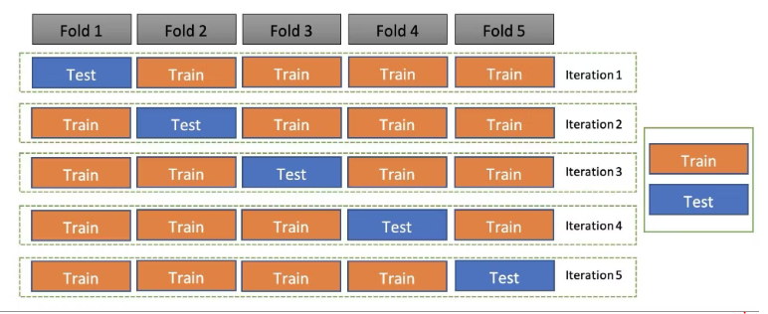
K-Fold Cross Validation

Slide 5
Holdout cross-validation
It is also called a train-test split.
Holdout cross-validation has the entire dataset partitioned randomly into a training set and a validation set.
A rule of thumb to partition data is that nearly 70% of the whole dataset will be used as a training set and the remaining 30% will be used as a validation set.
Since the dataset is split into only two sets, the model is built just one time on the training set and executed faster.

Slide 6
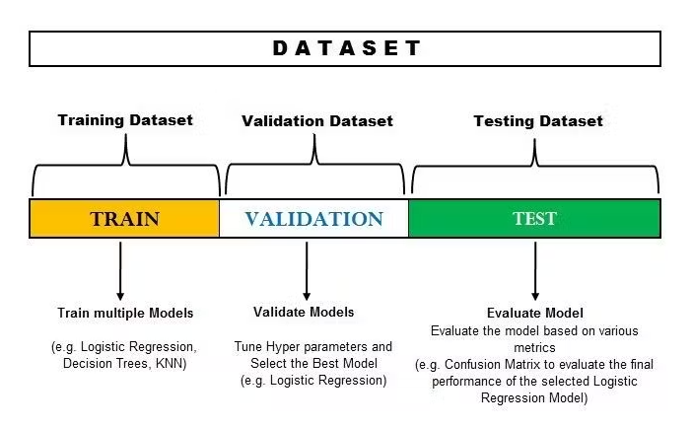
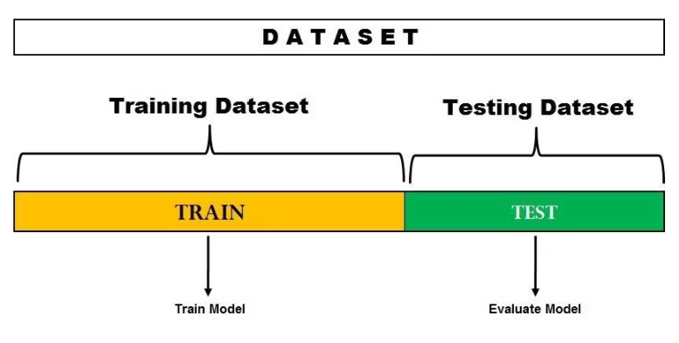
Holdout cross-validation

Slide 7
Stratified K-Fold Cross Validation
It is an enhanced version of the k-fold cross-validation technique.
Although it too splits the dataset into k equal folds, each fold has the same ratio of instances of target variables that are in the complete dataset.

Slide 8
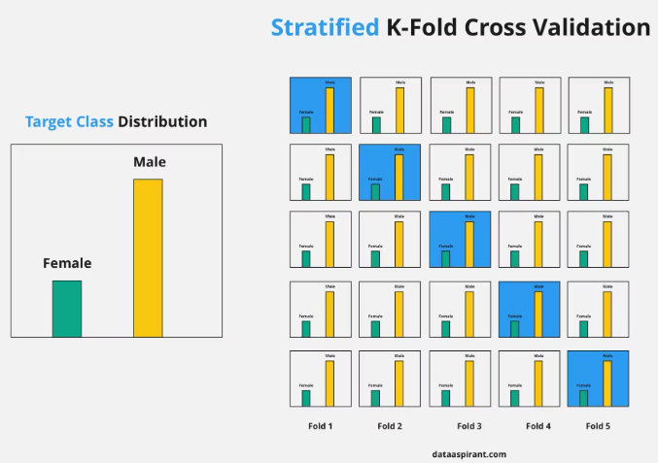
Stratified K-Fold Cross Validation

Slide 9
Leave-p-out Cross Validation
It is an enhanced exhaustive cross-validation technique.
If dataset has n samples then p samples are used as validation set
N-p samples are used for training.
This process is repeated until the entire dataset containing n samples gets divided on the validation set of p samples and the training set of n-p samples.
Disadvantage:
Not suitable for imbalanced dataset

Slide 10
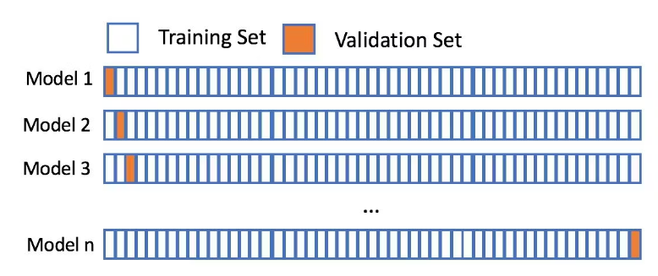
Leave-one-out Cross Validation
In this technique only one sample is used as validation set.
N-1 samples are used as training set

Slide 11
Monte Carlo cross-validation
It is also known as shuffle split cross validation or repeated random subsampling cross validation.
Here the data is split into training and test data.
Splitting can be done in percentage of 70%-30% or 60%-40% and so on.
The only condition for each iteration is to keep train and test split % different.
Then, fit the model on the training dataset in that iteration and calculate the accuracy of the fitted model on the test dataset.
Repeat the iteration many times 100,400,500 times
Take the average of all the test errors.

Slide 12
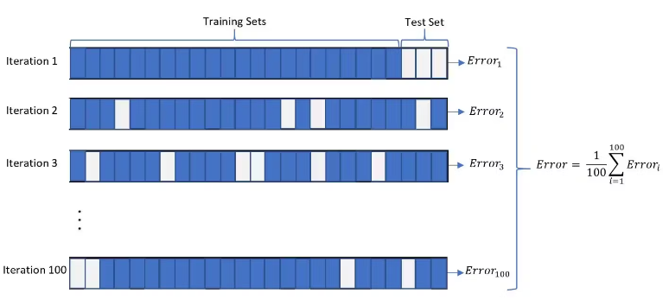
Monte Carlo cross-validation

Slide 13
Time series cross-validation
It is also known as rolling cross validation or forward chaining method.
It is used in time series datasets.
Since the order of data is very important for time series-related problems, the dataset is split into training and validation sets according to time.
Therefore, it’s also called the forward chaining method or rolling cross-validation.
Start the training with a small subset of data.
Perform forecasting for the later data points and check their accuracy.
he forecasted data points are then included as part of the next training dataset and the next data points are forecasted.
The process goes on.

Slide 14
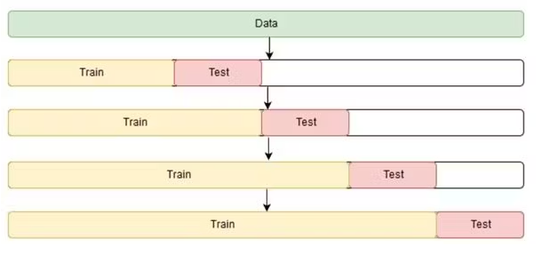
Time series cross-validation

Slide 15

Thank you

